Slide 1

Tuesday, October 23, 2012
TISK Problems
Multiply: $\frac{12}{5}\left(\frac{20}{3}\right)$
What is the probability of rolling a number greater than 7 on a 20-sided die?
Convert to a percent: $4\frac{5}{9}$
We will have 3 Mental Math questions today.
Homework: Counting Principle Practice worksheet
Notes:
Mental Math
Start with the product of 12 and 9. Divide by 2. Multiply by 10. Divide by 9. Multiply by 14. Divide by 12. Multiply by 6. (420)
Start with the product of 7 and 8. Divide by 2. Multiply by 10. Divide by 7. Multiply by 18. Divide by 12. Multiply by 8. (480)
Start with the product of 9 and 6. Divide by 2. Multiply by 10. Divide by 6. Multiply by 20. Divide by 15. Multiply by 7. (420)

Slide 2
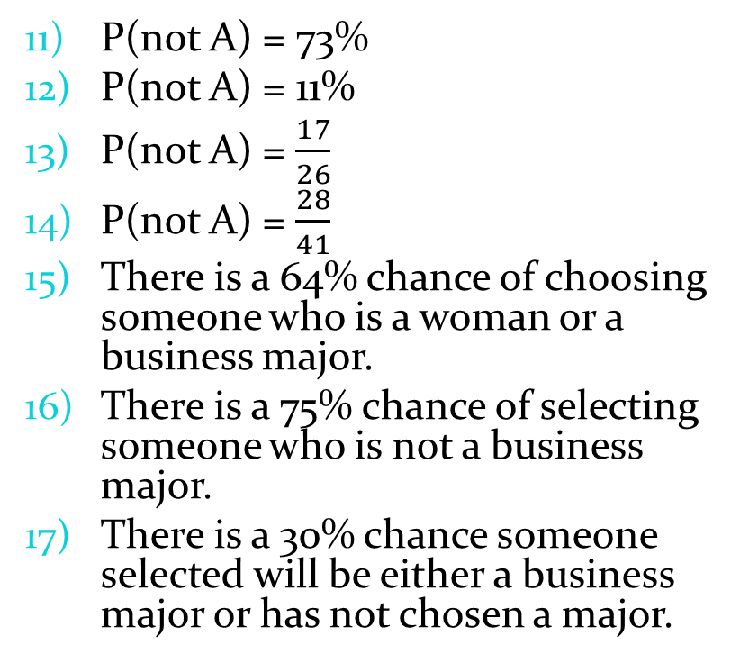
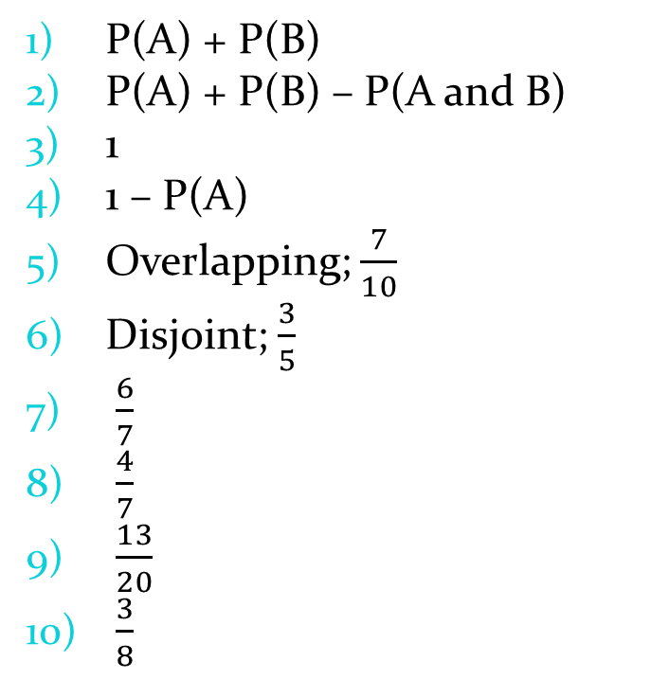
Homework Check
P(A) + P(B)
P(A) + P(B) – P(A and B)
1
1 – P(A)
Overlapping; $\frac{7}{10}$
Disjoint; $\frac{3}{5}$
$\frac{6}{7}$
$\frac{4}{7}$
$\frac{13}{20}$
$\frac{3}{8}$
P(not A) = 73%
P(not A) = 11%
P(not A) = $\frac{17}{26}$
P(not A) = $\frac{28}{41}$
There is a 64% chance of choosing someone who is a woman or a business major.
There is a 75% chance of selecting someone who is not a business major.
There is a 30% chance someone selected will be either a business major or has not chosen a major.

Slide 3
§9-5 Counting Principle
Jazmyne has packed 3 shirts, 2 pairs of pants, and a jacket for her camping trip. How many different outfits does she have?

Slide 4
§9-5 Counting Principle
Jazmyne has packed 3 shirts, 2 pairs of pants, and a jacket for her camping trip. How many different outfits does she have?
pants #1
This is a tree diagram.
It is one way to determine how may options you have.
Shirt #1
pants #2
pants #1
Shirt #2
pants #2
pants #1
Shirt #3
pants #2

Slide 5
§9-5 Counting Principle
Make a tree diagram to determine how many car packages you can choose from if you are buying a car with the following choices:
Color: blue, red, or white
Style: Van, Sedan, Convertible, SUV
Trim: Chrome, Wood

Slide 6
§9-5 Counting Principle
As you can guess, these trees can get pretty complex.
Imagine you’re trying to create a password for an internet account. The password must be 5 letters or numbers, you cannot use 0, and it is case sensitive. How many different 5-character passwords can you create?
Make a tree diagram…?
There must be an easier way!

Slide 7
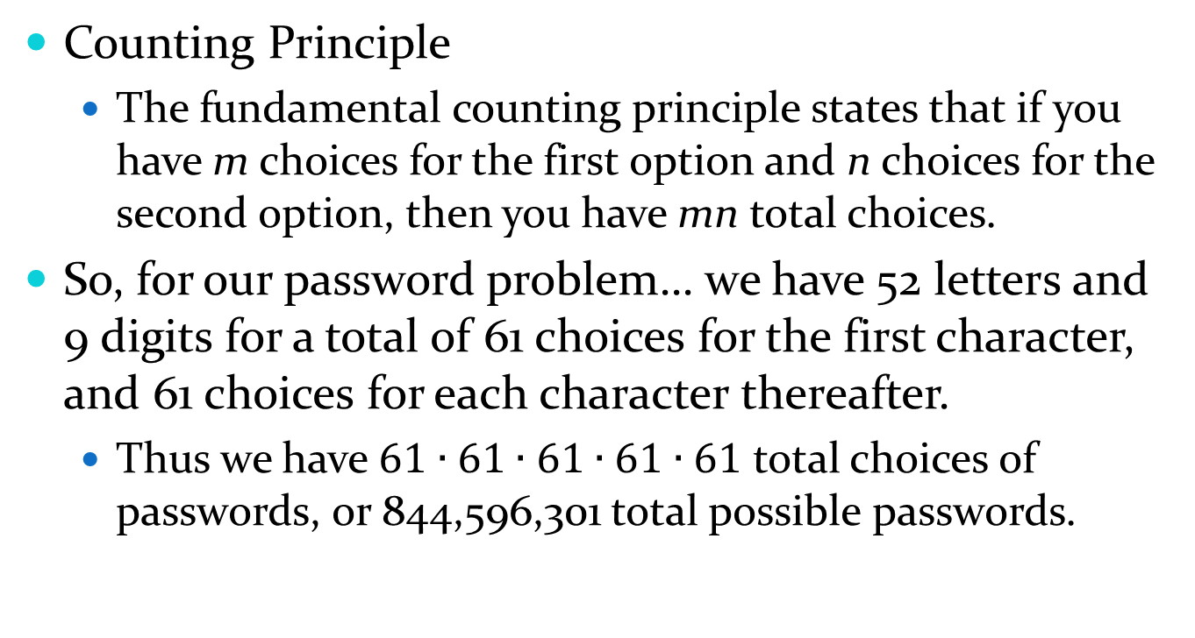
§9-5 Counting Principle
Counting Principle
The fundamental counting principle states that if you have m choices for the first option and n choices for the second option, then you have mn total choices.
So, for our password problem… we have 52 letters and 9 digits for a total of 61 choices for the first character, and 61 choices for each character thereafter.
Thus we have $61∙61∙61∙61∙61$ total choices of passwords, or 844,596,301 total possible passwords.

Slide 8


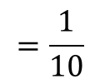

§9-5 Counting Principle
Minerva rolls a 10-sided die and spins the spinner below. What’s the probability she gets the same number on each one?
8
1
$$P\left(same number\right)=$$
$$\frac{8}{8}$$
$$∙\frac{1}{10}$$
$$=\frac{1}{10}$$
6
3
4
5
2
7

